Slide 1
Art for brotherhood, culture and peace
“Brotherhood through art and language: a historical overview”

Slide 2
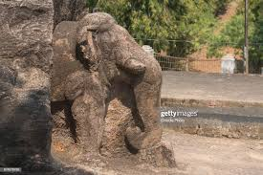
Ashoka’s art for peace:
The calm elephant in Dhauli

Slide 3
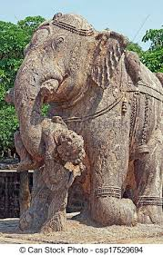
Opposed to the war elephant in the art at Konarka in the same Kalinga region, many centuries later

Slide 4
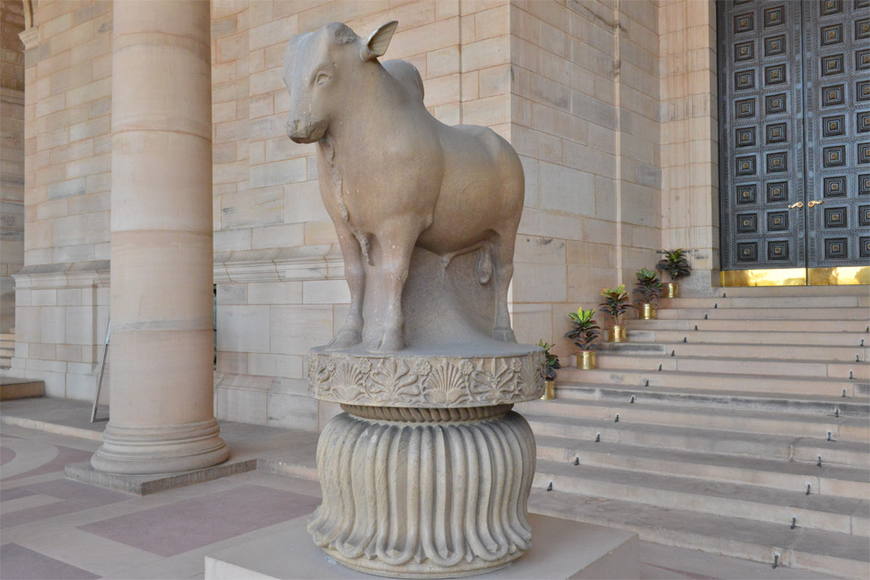
Ashoka’s art work: The Bull from Rampurva (exhibited at the President’s House in New Delhi)

Slide 5
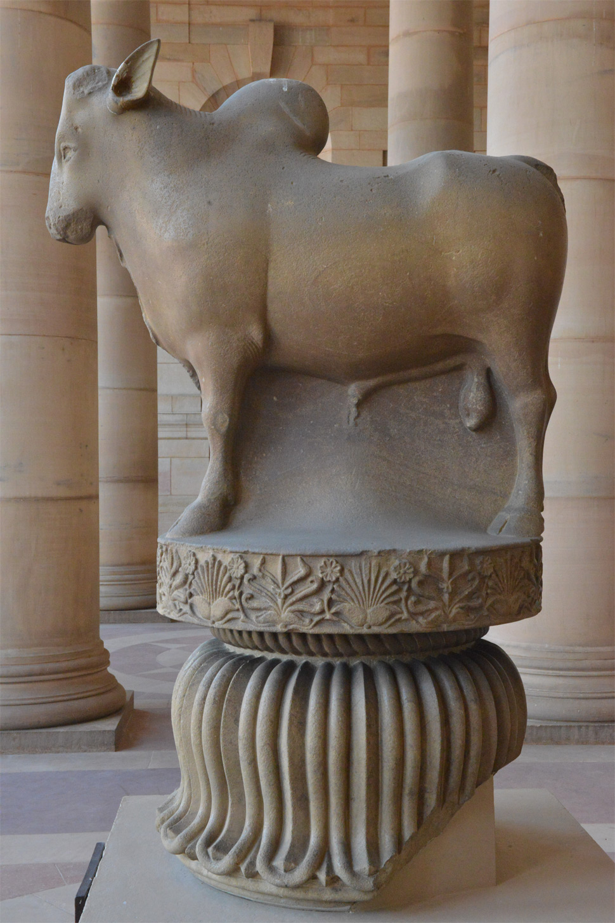
Rampurva Bull at Rashtrapati Bhawan, New Delhi

Slide 6
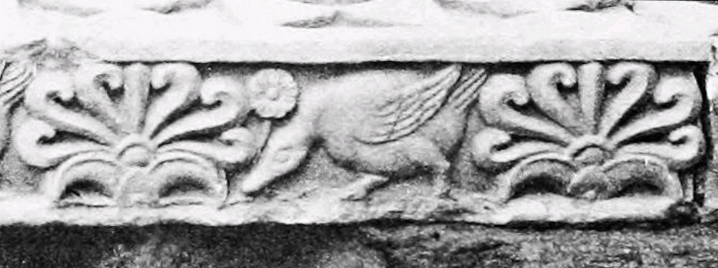
The happy goose in Ashoka art: symbolic of the people

Slide 7
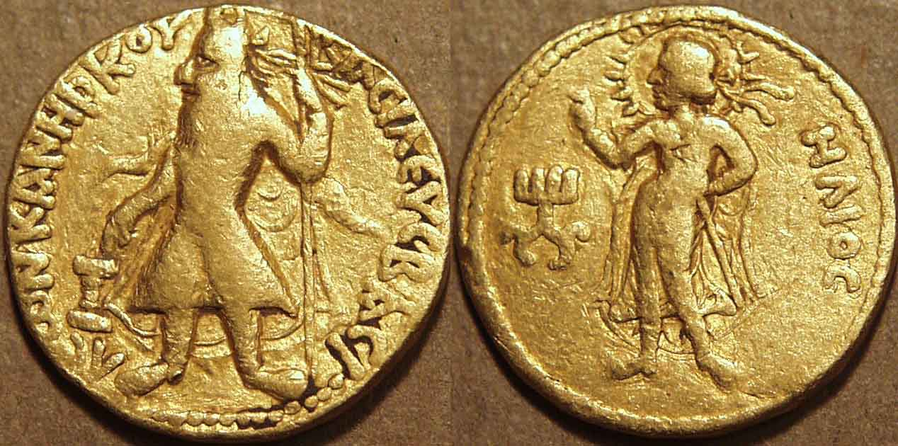
Kanishka coin of Greek god Helios

Slide 8
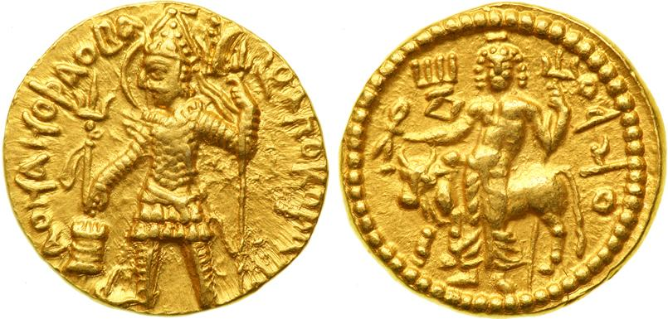
Kanishka’s coin of God Shiva

Slide 9
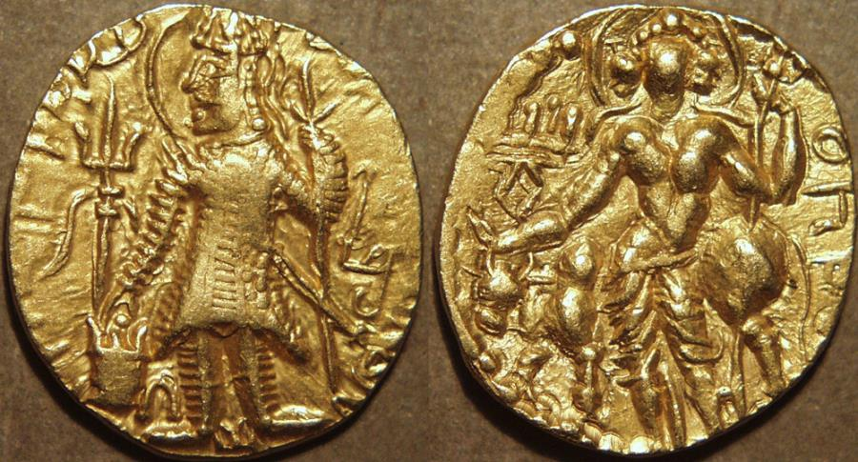
Another “Shiva” coin by Kanishka

Slide 10
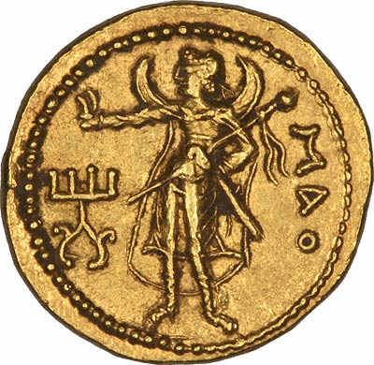
Kanishka’s coin of Chinese Moon god Mao

Slide 11
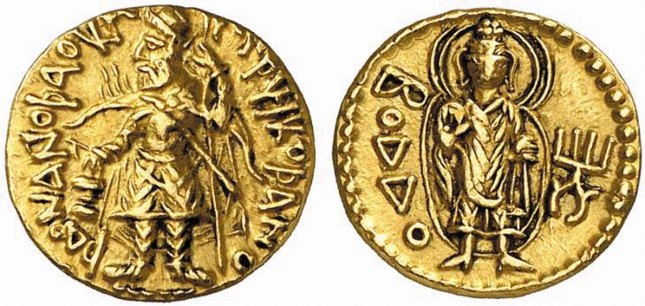
Kanishka’s coin of Buddha

Slide 12
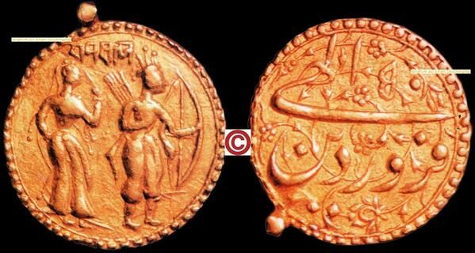
Akbar’s coin of Ram and Sita

Slide 13
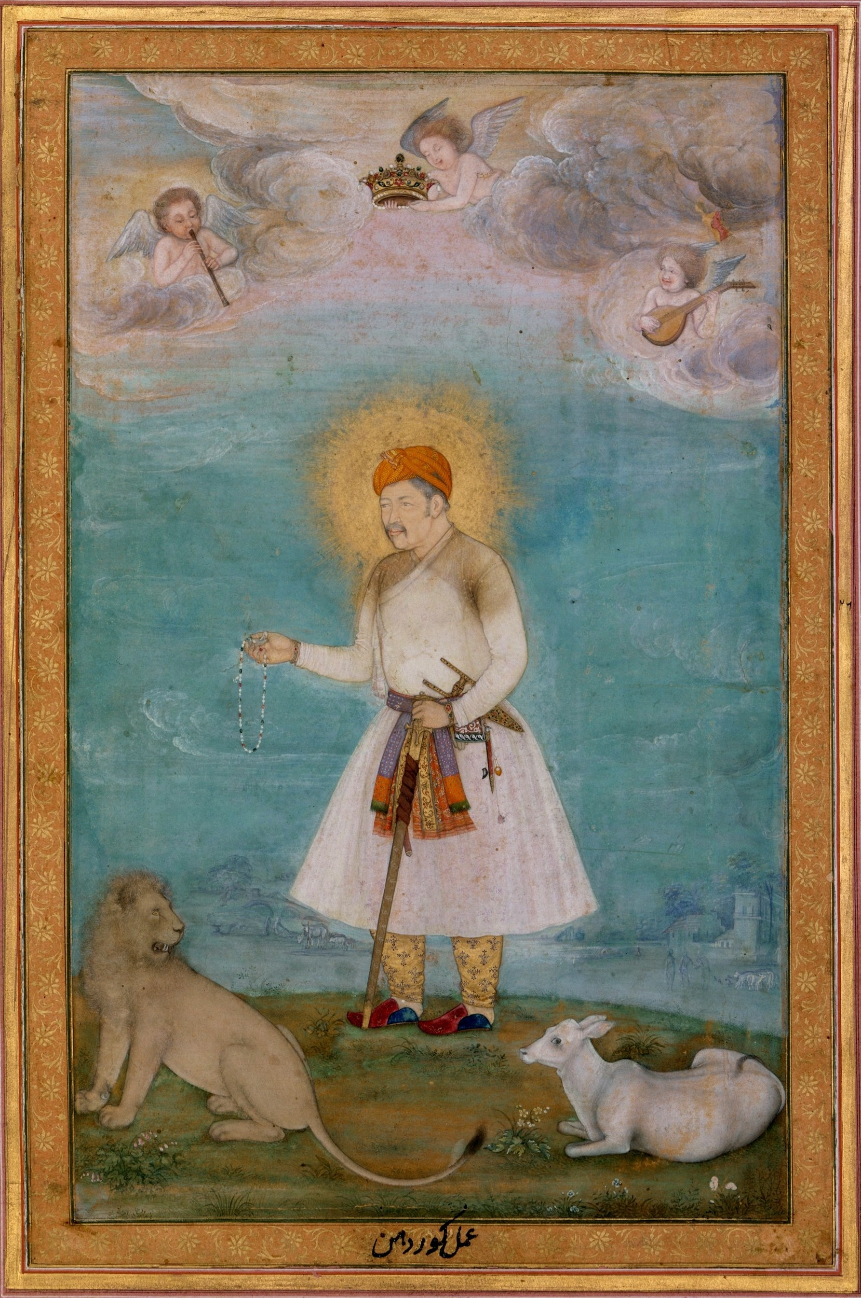
Akbar’s reign:
Goat and Lion
drink from the same source

Slide 14
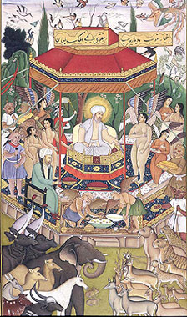
Religious harmony;
a Mughal miniature painting

Slide 15
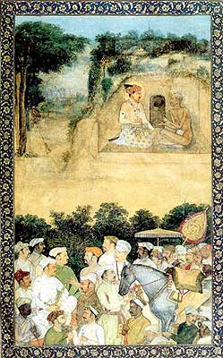
Jahangir’s visit to Jadrup, a Hindu saint

Slide 16
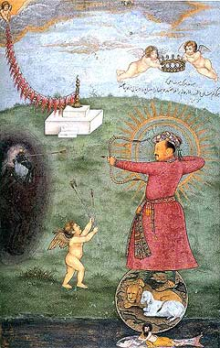
Jahangir attacking Poverty

Slide 17
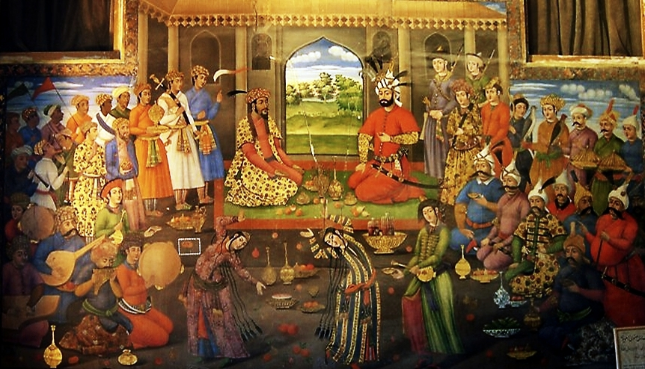
Humayun and Shah

Slide 18
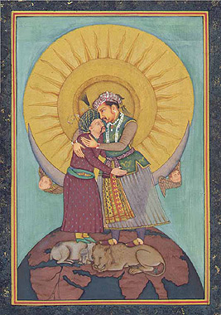
Jahangir and Shah Abbas
( the goat and lion at feet symbolize peace in world)

Slide 19
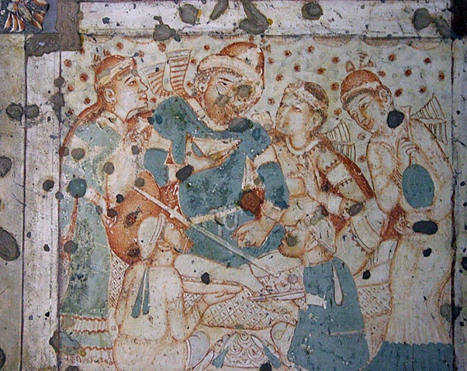
Sassanian envoy entertained by Rashtrakuta court:
Ajanta fresco

Slide 20

Evolved symbol of Peace

Slide 21
THANK YOU...

